Slide 1
Paging
Operating Systems: Internals and Design Principles
Notes:
“Operating Systems: Internal and Design Principles”, 7/e, by William Stallings, Chapter 7 “Memory Management”.

Slide 2
Paging
Partition memory into equal fixed-size chunks that are relatively small
Process is also divided into small fixed-size chunks of the same size
Pages
chunks of a process
Frames
available chunks of memory
Notes:
Both unequal fixed-size and variable-size partitions are inefficient in the use of memory; the former results in internal fragmentation, the latter in external fragmentation. Suppose, however, that main memory is partitioned into equal fixed-size chunks that are relatively small, and that each process is also divided into small fixed-size chunks of the same size. Then the chunks of a process, known as pages , could be assigned to available chunks of memory, known as frames , or page frames. We show in this section that the wasted space in memory for each process is due to internal fragmentation consisting of only a fraction of the last page of a process. There is no external fragmentation.

Slide 3
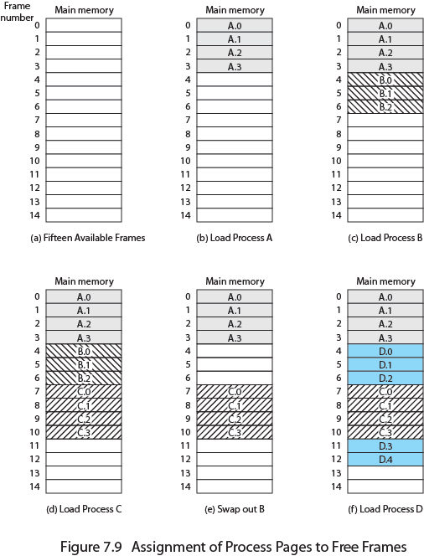
Assignment of Process to Free Frames
Notes:
Figure 7.9 illustrates the use of pages and frames. At a given point in time, some of the frames in memory are in use and some are free. A list of free frames is maintained by the OS. Process A, stored on disk, consists of four pages. When it is time to load this process, the OS finds four free frames and loads the four pages of process A into the four frames ( Figure 7.9b ). Process B, consisting of three pages, and process C, consisting of four pages, are subsequently loaded. Then process B is suspended and is swapped out of main memory. Later, all of the processes in main memory are blocked, and the OS needs to bring in a new process, process D, which consists of five pages.
Now suppose, as in this example, that there are not sufficient unused contiguous frames to hold the process. Does this prevent the operating system from loading D? The answer is no, because we can once again use the concept of logical address.

Slide 4
Page Table
Maintained by operating system for each process
Contains the frame location for each page in the process
Processor must know how to access for the current process
Used by processor to produce a physical address
Notes:
A simple base address register will no longer suffice. Rather, the operating system maintains a page table for each process. The page table shows the frame location for each page of the process. Within the program, each logical address consists of a page number and an offset within the page. Recall that in the case of simple partition, a logical address is the location of a word relative to the beginning of the program; the processor translates that into a physical address. With paging, the logical-to-physical address translation is still done by processor hardware. Now the processor must know how to access the page table of the current process. Presented with a logical address (page number, offset), the processor uses the page table to produce a physical address (frame number, offset).

Slide 5
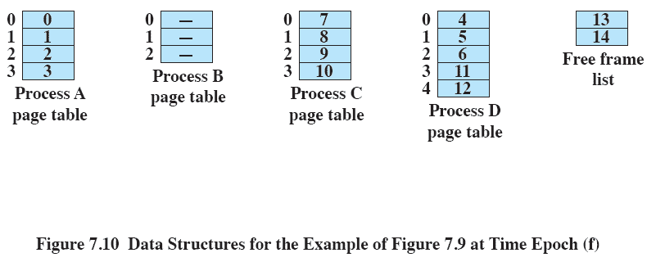
Data Structures
Notes:
Continuing our example, the five pages of process D are loaded into frames 4, 5, 6, 11, and 12. Figure 7.10 shows the various page tables at this time. A page table contains one entry for each page of the process, so that the table is easily indexed by the page number (starting at page 0 ). Each page table entry contains the number of the frame in main memory, if any, that holds the corresponding page. In addition, the OS maintains a single free-frame list of all the frames in main memory that are currently unoccupied and available for pages.
Thus we see that simple paging, as described here, is similar to fixed partitioning. The differences are that, with paging, the partitions are rather small; a program may occupy more than one partition; and these partitions need not be contiguous.

Slide 6
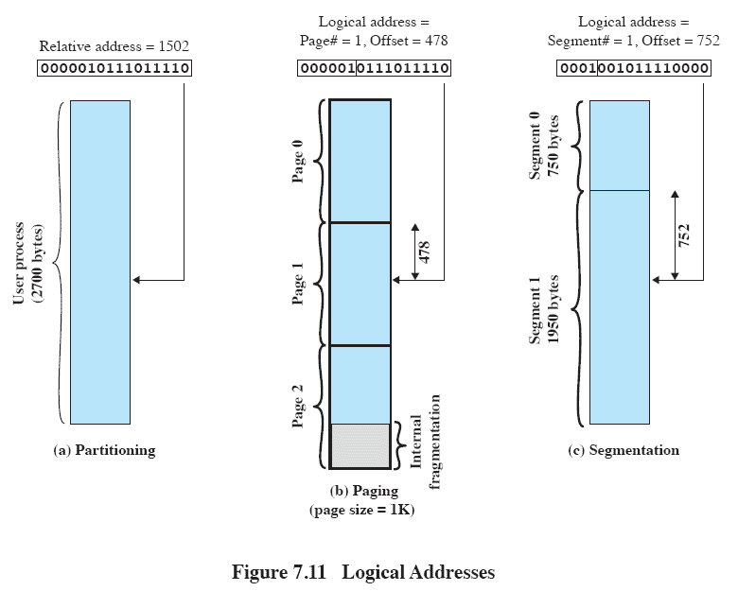
Logical Addresses
Notes:
To make this paging scheme convenient, let us dictate that the page size, hence the frame size, must be a power of 2. With the use of a page size that is a power of 2, it is easy to demonstrate that the relative address, which is defined with reference to the origin of the program, and the logical address, expressed as a page number and offset, are the same. An example is shown in Figure 7.11 . In this example, 16-bit addresses are used, and the page size is 1K 1,024 bytes. The relative address 1502, in binary form, is 0000010111011110. With a page size of 1K, an offset field of 10 bits is needed, leaving 6 bits for the page number. Thus a program can consist of a maximum of 2 6 64 pages of 1K bytes each. As Figure 7.11b shows, relative address 1502 corresponds to an offset of 478 (0111011110) on page 1 (000001), which yields the same 16-bit number, 0000010111011110.
The consequences of using a page size that is a power of 2 are twofold. First, the logical addressing scheme is transparent to the programmer, the assembler, and the linker. Each logical address (page number, offset) of a program is identical to its relative address. Second, it is a relatively easy matter to implement a function in hardware to perform dynamic address translation at run time. Consider an address of n + m bits, where the leftmost n bits are the page number and the rightmost m bits are the offset. In our example ( Figure 7.11b ), n 6 and m 10. The following steps are needed for address translation:
• Extract the page number as the leftmost n bits of the logical address.
• Use the page number as an index into the process page table to find the frame number, k .
• The starting physical address of the frame is k °— 2 m
and the physical address of the referenced byte is that number plus the offset. This physical address need not be calculated; it is easily constructed by appending the frame number to the offset.

Slide 7
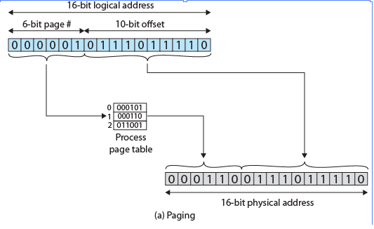
Logical-to-Physical Address
Translation - Paging
Notes:
In our example, we have the logical address 0000010111011110, which is page number 1, offset 478. Suppose that this page is residing in main memory frame 6 binary 000110. Then the physical address is frame number 6, offset 478 0001100111011110 ( Figure 7.12a ).

Slide 8

Segmentation
A program can be subdivided into segments
may vary in length
there is a maximum length
Addressing consists of two parts:
segment number
an offset
Similar to dynamic partitioning
Eliminates internal fragmentation
Notes:
A user program can be subdivided using segmentation, in which the program and its associated data are divided into a number of segments . It is not required that all segments
of all programs be of the same length, although there is a maximum segment length. As with paging, a logical address using segmentation consists of two parts, in this case a segment number and an offset.
Because of the use of unequal-size segments, segmentation is similar to dynamic partitioning. In the absence of an overlay scheme or the use of virtual
memory, it would be required that all of a program’s segments be loaded into memory for execution. The difference, compared to dynamic partitioning, is that with
segmentation a program may occupy more than one partition, and these partitions need not be contiguous. Segmentation eliminates internal fragmentation but, like
dynamic partitioning, it suffers from external fragmentation. However, because a process is broken up into a number of smaller pieces, the external fragmentation
should be less.

Slide 9
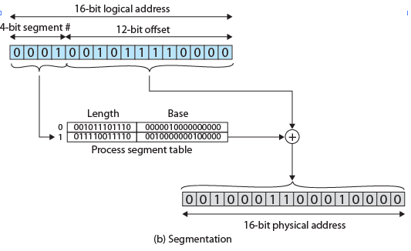
Logical-to-Physical Address Translation - Segmentation
Notes:
In our example, we have the logical address 0001001011110000, which is segment number 1, offset 752. Suppose that this segment is residing in main memory starting at physical address 0010000000100000. Then the physical address is 0010000000100000 + 001011110000 0010001100010000 ( Figure 7.12b ).

Slide 10

Security Issues
If a process has not declared a portion of its memory to be sharable, then no other process should have access to the contents of that portion of memory
If a process declares that a portion of memory may be shared by other designated processes then the security service of the OS must ensure that only the designated processes have access

Slide 11
Buffer Overflow Attacks
Security threat related to memory management
Also known as a buffer overrun
Can occur when a process attempts to store data beyond the limits of a fixed-sized buffer
One of the most prevalent and dangerous types of security attacks
Notes:
One serious security threat related to memory management remains to be introduced:
buffer overflow , also known as a buffer overrun , which is defined in the NIST
(National Institute of Standards and Technology) Glossary of Key Information
Security Terms as follows:
buffer overrun: A condition at an interface under which more input can be
placed into a buffer or data-holding area than the capacity allocated, overwriting
other information. Attackers exploit such a condition to crash a system or to
insert specially crafted code that allows them to gain control of the system.
A buffer overflow can occur as a result of a programming error when a process
attempts to store data beyond the limits of a fixed-sized buffer and consequently
overwrites adjacent memory locations. These locations could hold other program
variables or parameters or program control flow data such as return addresses
and pointers to previous stack frames. The buffer could be located on the stack,
in the heap, or in the data section of the process. The consequences of this error
include corruption of data used by the program, unexpected transfer of control in
the program, possibly memory access violations, and very likely eventual program
termination. When done deliberately as part of an attack on a system, the transfer
of control could be to code of the attacker’s choosing, resulting in the ability to
execute arbitrary code with the privileges of the attacked process. Buffer overflow
attacks are one of the most prevalent and dangerous types of security attacks.

Slide 12
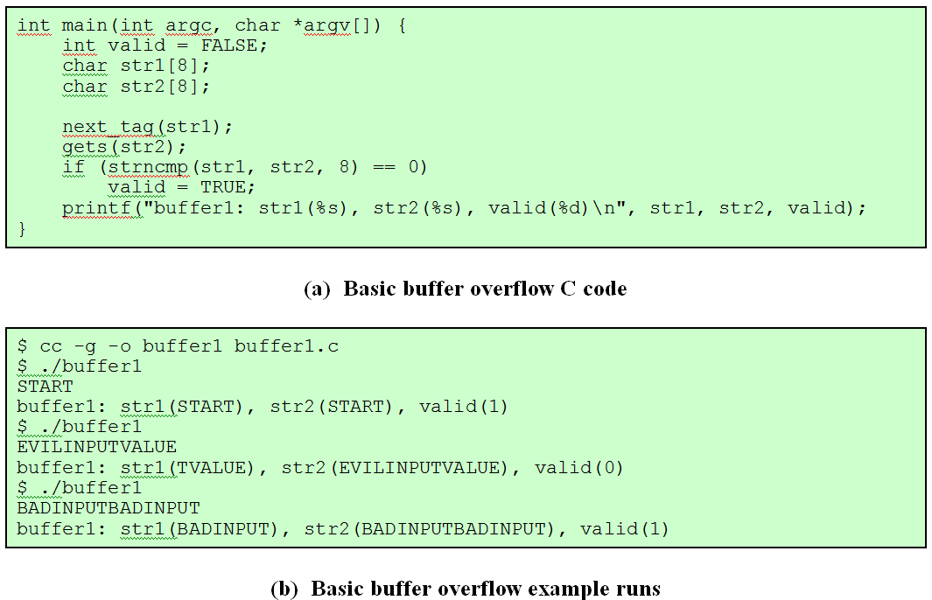
Buffer Overflow Example
Notes:
To illustrate the basic operation of a common type of buffer overflow,
known as stack overflow , consider the C main function given in Figure 7.13a . This
contains three variables ( valid , str1 , and str2 ), 2 whose values will typically
be saved in adjacent memory locations. Their order and location depends on the
type of variable (local or global), the language and compiler used, and the target
machine architecture.

Slide 13
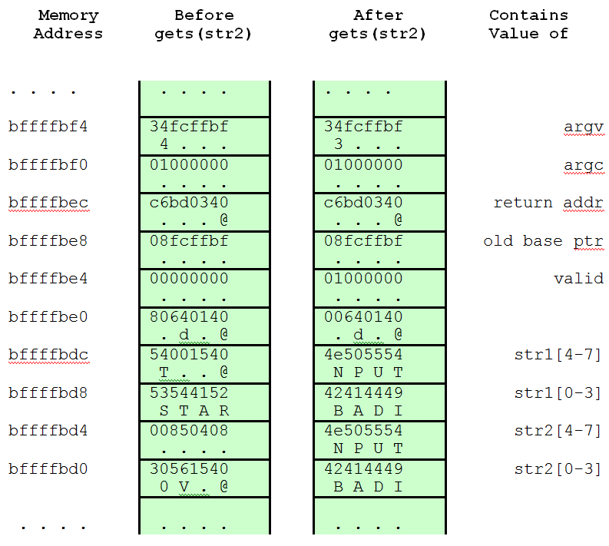
Buffer Overflow Stack Values
Notes:
Figure 7.14 Basic Buffer Overflow Stack Values

Slide 14
Defending Against Buffer Overflows
Prevention
Detecting and aborting
Countermeasure categories:
Compile-time Defenses
aim to harden programs to resist attacks in new programs
Run-time Defenses
aim to detect and abort attacks in existing programs
Notes:
Finding and exploiting a stack buffer overflow is not that difficult. The large number
of exploits over the previous couple of decades clearly illustrates this. There
is consequently a need to defend systems against such attacks by either preventing
them or at least detecting and aborting such attacks. Countermeasures can be
broadly classified into two categories:
• Compile-time defenses, which aim to harden programs to resist attacks in new
programs
• Run-time defenses, which aim to detect and abort attacks in existing programs
While suitable defenses have been known for a couple of decades, the very
large existing base of vulnerable software and systems hinders their deployment.
Hence the interest in run-time defenses, which can be deployed in operating
systems and updates and can provide some protection for existing vulnerable
programs.

Slide 15
Summary
Memory Management
one of the most important and complex tasks of an operating system
needs to be treated as a resource to be allocated to and shared among a number of active processes
desirable to maintain as many processes in main memory as possible
desirable to free programmers from size restriction in program development
basic tools are paging and segmentation (possible to combine)
paging – small fixed-sized pages
segmentation – pieces of varying size
Notes:
Chapter 7 Summary
One of the most important and complex tasks of an operating system is memory
management. Memory management involves treating main memory as a resource
to be allocated to and shared among a number of active processes. To use the processor
and the I/O facilities efficiently, it is desirable to maintain as many processes
in main memory as possible. In addition, it is desirable to free programmers from
size restrictions in program development.
The basic tools of memory management are paging and segmentation. With
paging, each process is divided into relatively small, fixed-size pages. Segmentation
provides for the use of pieces of varying size. It is also possible to combine segmentation
and paging in a single memory management scheme.

